Slide 1



303105104 - Computational Thinking for Structured Design-1
Prof. INDU JAISWAL, Assistant Professor Computer Science & Engineering

Slide 2


CHAPTER-3
Conditional Flow Statements, Iterative Statements, Jumping Statements and Pointers

Slide 3
Contents
Conditional Flow Statements(Decision making)
Iterative Statements (Loops)
Jumping statements (break and continue statements)
Pointers

Slide 4
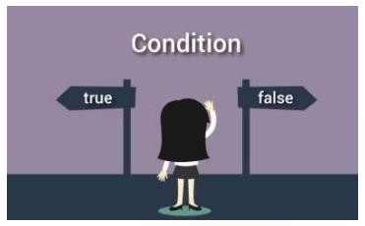
1. Decision Making
Decision making is used to specify the order in which statements are executed.
Decision making in a C program using:-
if statement
if…else statement
if…else if…else statement
nested if...else statement
Switch case Statement

Slide 5
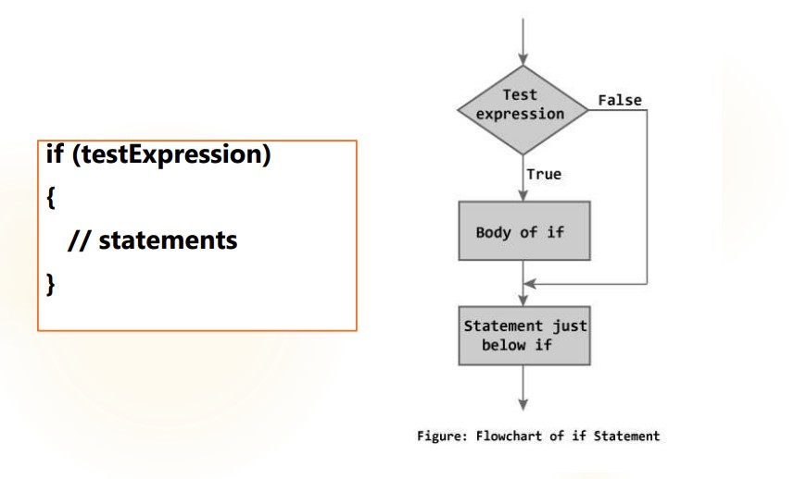
1.1 if statement

Slide 6
Example: if statement
Program to display only negative numbers on screen.
#include <stdio.h> int main()
{
int number;
printf("Enter an integer: "); scanf("%d", &number);
// Test expression is true if number is less than 0
if (number < 0) {
printf("You entered %d.\n", number);
}
printf("The if statement is easy."); return 0;
}

Slide 7
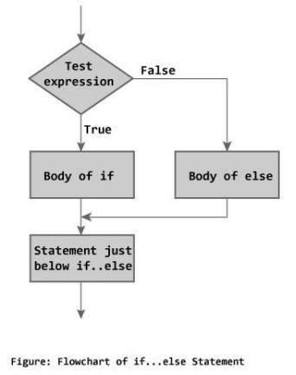
1.2 if...else statement
if...else statement executes some code if the test expression is true (nonzero) and some other code if the test expression is false (0).
Syntax of if...else
if (test Expression)
{
// codes inside the body of if
}
else
{
// codes inside the body of else
}

Slide 8
Example: if...else statement
// Program to check whether an integer entered by the user is odd or even
#include <stdio.h>
int main()
{
int number;
printf("Enter an integer: "); scanf("%d",&number);
// True if remainder is 0
if( number%2 == 0 )
printf("%d is an even integer.",number); else
printf("%d is an odd integer.",number);
return 0;
}

Slide 9
1.3 if...else if....else Statement
The if...else statement executes two different codes depending upon whether the test expression is true or false. Sometimes, a choice has to be made from more than 2 possibilities.
The if...else if…else statement allows you to check for multiple test expressions and execute different codes for more than two conditions

Slide 10
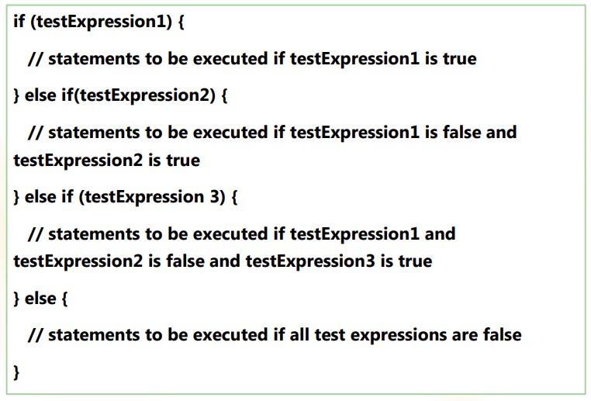
Syntax of if...else if....else statement.

Slide 11
Example: if...else if....else statement
// Program to relate two integers
using =, > or < #include <stdio.h> int main()
{
int number1, number2;
printf("Enter two integers: "); scanf("%d %d", &number1,&number2);
//checks if two integers are equal. if(number1 == number2)
{
printf("Result: %d = %d“,number1,number2);
}
//checks if number1 is greater than number2.
else if (number1 > number2)
{
printf("Result: %d > %d", number1, number2);
}
// if both test expression is false else {
printf("Result: %d < %d",number1, number2);
}
return 0;
}

Slide 12
1.4 Nested if else statement
Nested if else statement is same like if else statement, where new block of if else statement is defined in existing if else statement.
Used when need to check more than one conditions at a time

Slide 13
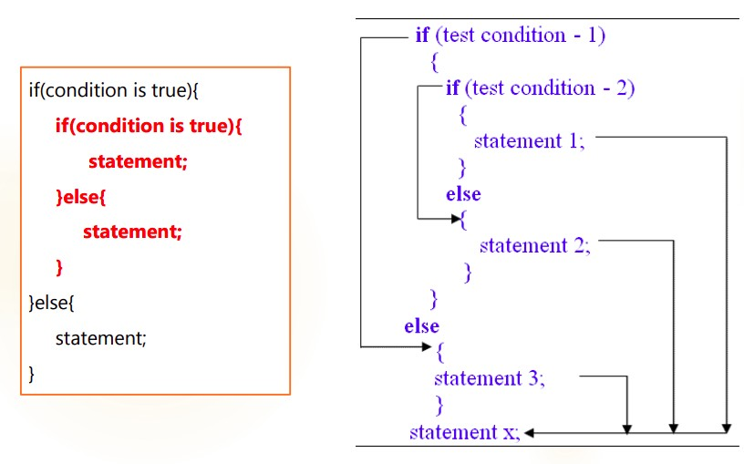
Syntax of Nested If else Statement

Slide 14
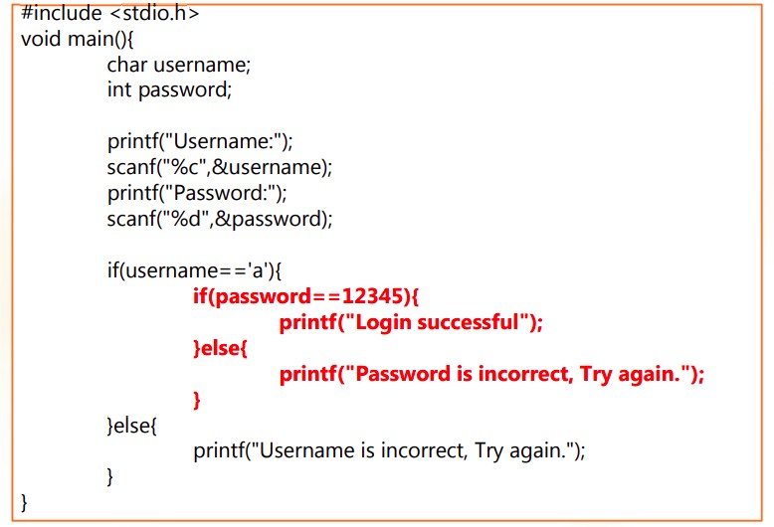
Example of Nested if else Statement

Slide 15

2. Loops
Loops are used in programming to repeat a specific block until some end condition is met.
►
There are three loops in C programming:
for loop
while loop
do...while loop
Nested loops

Slide 16
2.1 for Loop
The syntax of a for loop is:
for (initialization; testExpression; Increment or decrement)
{
// codes
}

Slide 17
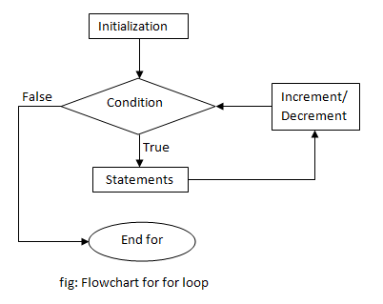
Flowchart of For Loop

Slide 18
Example: for loop
// Program to calculate the sum of first n natural numbers
// Positive integers 1,2,3...n are known as natural numbers
#include <stdio.h> int main(){
int n, count, sum = 0; printf("Enter a positive integer: "); scanf("%d", &n);
for(count = 1; count <= n; ++count)
{
sum =sum+count;
}
printf("Sum = %d", sum); return 0;
}

Slide 19
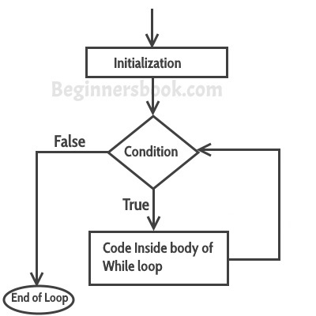
2.2 while loop
The syntax of a while loop is:
while (testExpression)
{
//codes
}

Slide 20
Example: while loop
/ Program to find factorial of a number
// For a positive integer n, factorial = 1*2*3...n
#include<stdio.h> int main(){
int number; long factorial;
printf("Enter an integer: "); scanf("%d",&number);
factorial =1;
// loop terminates when number is less than or equal to 0
while (number > 0) {
// factorial = factorial*number;
factorial *= number;
--number;
}
printf("Factorial= %lld", factorial); return 0;

Slide 21
2.3 do...while loop
The do..while loop is similar to the while loop with one important difference.
The body of do...while loop is executed once, before checking the testexpression.
The do...while loop is executed at least once.

Slide 22
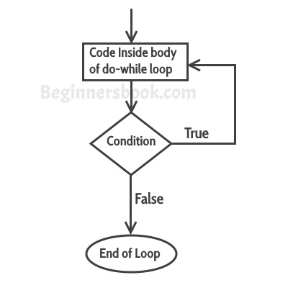
do...while loop Syntax
do
{
// codes
}
while (testExpression);

Slide 23
Example: do...while loop
// Program to add numbers until user enters zero #include <stdio.h>
int main() {
double number, sum = 0;
// loop body is executed at least once
do{
printf("Enter a number: ");
scanf("%lf", &number); sum
+= number;
}while(number != 0.0);
printf("Sum %.2lf",sum); return 0;}

Slide 24
2.4 Nested loops
for ( init; condition; increment )
{
for ( init; condition; increment )
{
statement(s); // inner loop
}
statement(s);// outer loop
}
Defining loop within another loop is called nested loops

Slide 25
2.4 Nestedloops (Con..)
►
Syntax while loop
while(condition)
{
while(condition)
{
statement(s);
}
statement(s);
}

Slide 26

3. Break And Continue Statement
►
What is BREAK meant?
►
What is CONTINUE meant?

Slide 27
Syntax of if...else if....else statement.
The break statement terminates the loop immediately when it is encountered.
The break statement is used with decision making statement such as if...else.
►
►
Syntax of break statement
break;

Slide 28
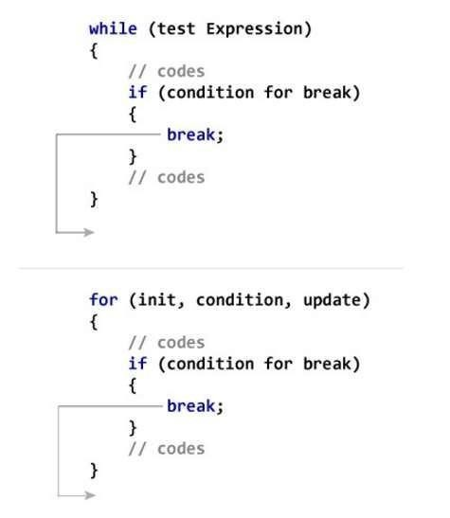
How break statement works?

Slide 29
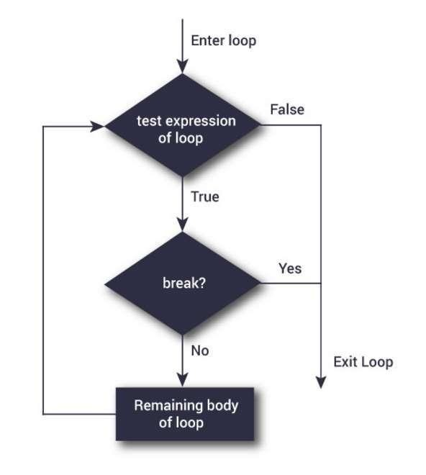
Flowchart Of Break Statement

Slide 30
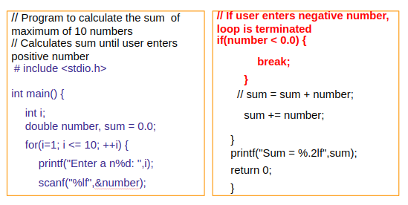
Example: break statement

Slide 31
3.2 Continue Statement
►
The continue statement skips some statements inside the loop.
The continue statement is used with decision making stateme such as if...else.
►
Syntax of continue Statement
continue;

Slide 32
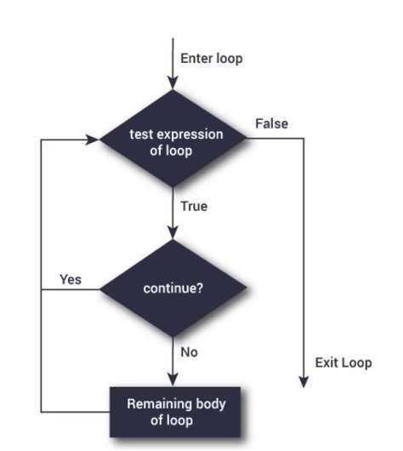
Flowchart of Continue Statement

Slide 33
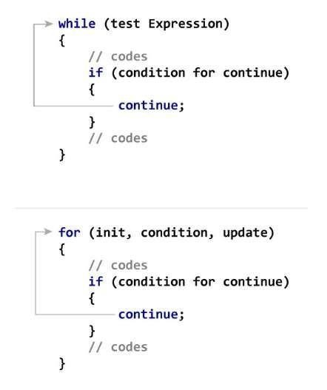
How Continue Statement Works?

Slide 34
Example: continue statement
// Program to calculate sum of maximum of 10 numbers
// Negative numbers are skipped
from calculation
# include <stdio.h>
int main(){
int i;
double number, sum = 0.0;
for(i=1; i <= 10; ++i) { printf("Enter a n%d: ",i); scanf("%lf",&number);
// If user enters negative number,
loop is terminated
if(number < 0.0) {
// sum = sum + number; sum += number;
printf("Sum = %.2lf",sum); return 0;
continue;
}
}
}

Slide 35

3.2. Switch Statement
The if...else if…else statement allows you to execute a block code among many alternatives. If you are checking on the value of a single variable in if...else if…else statement, it is better to use switch statement.
The switch statement is often faster than nested if...else (not always).
Also, the syntax of switch statement is cleaner and
easy to understand.

Slide 36
Syntax of switch...case
switch (n){
case constant1:
// code to be executed if n is equal to constant1;
break;
case constant2:
// code to be executed if n is equal to constant2; break;
….
default:
// code to be executed if n doesn't match any constant
}

Slide 37
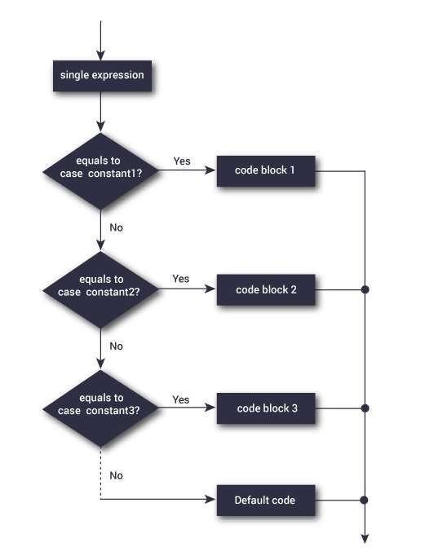
Switch Statement Flowchart

Slide 38
Example: switch Statement
// Program to create a simple calculator
// Performs addition, subtraction, multiplication or division depending the input from user
# include <stdio.h>
int main() {
char operator;
double firstNumber,secondNumber;
printf("Enter an operator (+, -, *,): "); scanf("%c", &operator); printf("Enter two operands: ");
scanf("%lf %lf",&firstNumber, &secondNumber);

Slide 39
Syntax of if...else if....else statement.
switch(operator) {
case '+':
printf("%.1lf + %.1lf = %.1lf",firstNumber, secondNumber, firstNumber+secondNumber); break;
case '-':
printf("%.1lf - %.1lf = %.1lf",firstNumber, secondNumber, firstNumber-secondNumber); break;
case '*':
printf("%.1lf * %.1lf = %.1lf",firstNumber, secondNumber, firstNumber*secondNumber); break;
case '/':
printf("%.1lf / %.1lf = %.1lf",firstNumber, secondNumber, firstNumber/firstNumber); break;
// operator is doesn't match any case constant (+, -, *, /) default:
printf("Error! operator is not correct");
}
return 0; }

Slide 40

3.3 goto Statement
The goto statement is used to alter the normal sequence of a C program.

Slide 41
Syntax of goto Statement
goto label;
... .. ...
... .. ...
... .. ...
label:
statement;

Slide 42
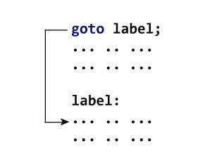
What is Label?
The label is an identifier. When goto statement is encountered, control of the program
jumps to label: and starts executing the code.

Slide 43
Example: goto Statement
// Program to calculate the sum and average of maximum of 5 number
// If user enters negative number, the sum and average of previously
entered positive number is displayed
# include <stdio.h> int main(){
const int maxInput = 5; int i; double number, average, sum=0.0;
for(i=1; i<=maxInput; ++i){
printf("%d. Enter a number: ", i); scanf("%lf",&number);

Slide 44
Example: goto Statement
// If user enters negative number, flow of program moves to label jump if(number < 0.0)
goto jump;
sum += number; // sum = sum+number;
}
Jump:
average=sum/(i-1); printf("Sum = %.2f\n", sum);
printf("Average = %.2f", average);
return 0; }

Slide 45
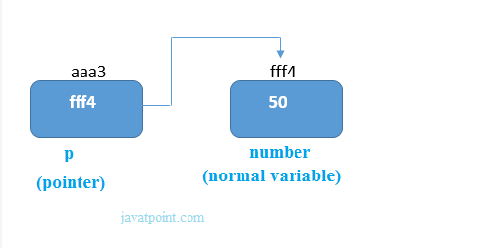
4. Pointer
The pointer is derived data type in C. Pointer is variable which stores the memory address of another variable. This variable can be of type int, char, array, function, or any other pointer.
Declaring pointer
Syntax
data_type *pt_name;
example
int number=50;
int *p;
p=&number;//stores the address of number variable

Slide 46
Pointer(Continue..)
Pointer can be typed or an untyped pointer points to an particular variable type such as an integer. An Untyped pointer points to any data type

Slide 47
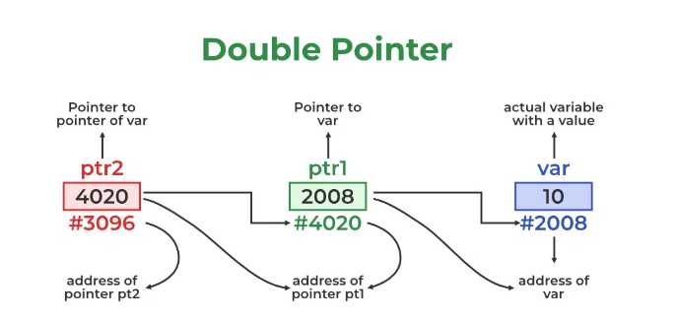
Double Pointer
The pointer to a pointer in C is used when we want to store the address of another pointer. The first pointer is used to store the address of the variable. And the second pointer is used to store the address of the first pointer. That is why they are also known as double-pointers

Slide 48
Double Pointer(continue..)
Declaration of Pointer to a Pointer in C
Syntax
data_type **name_of_variable = & normal_pointer_variable;
Example
int val = 5;
int *ptr = &val; // storing address of val to pointer ptr.
int **d_ptr = &ptr; // pointer to a pointer declared
// which is pointing to an integer.

Slide 49
Triple Pointer
A triple-pointer is a pointer that points to a memory location where a double-pointer is being stored. The triple-pointer itself is just one pointer.
Ex. int *** is a pointer, that points to the value of a double pointer, which in turn points to the value of a single pointer, which points to the value of an int. Syntax : Data_type ***variable_Name ; Example : int ***r ; r => This is double pointer variable and not normal variable

Slide 50
NULL Pointer
The Null Pointer is the pointer that does not point to any location.
We can create a null pointer by assigning the null value at the time of pointer declaration.
This method is useful when you do not assign any address to the pointer. A null pointer always contains value 0.
Syntax of Null Pointer
type pointer_name = NULL;
type pointer_name = 0;
// declaring null pointer
int* ptr = NULL;

Slide 51
Void Pointer
It is a pointer that has no associated data type with it. A void pointer can hold addresses of any type and can be typecast to any type.
It is also called a generic pointer and does not have any standard data type.
It is created by using the keyword void.
void *p = NULL; //void pointer

Slide 52
Wild Pointer
Wild pointers are also called uninitialized pointers. Because they point to some arbitrary memory location and may cause a program to crash or behave badly.
This type of C pointer is not efficient. Because they may point to some unknown memory location which may cause problems in our program. This may lead to the crashing of the program.
example
#include <stdio.h>
int main()
{
int *p; //wild pointer
printf("%d",*p);
return 0;
}

Slide 53
Const Pointer
A constant pointer in C cannot change the address of the variable to which it is pointing, i.e., the address will remain constant.
Syntax of Constant Pointer
<type of pointer> *const <name of pointer>;
Example
int *const ptr;
Int a =1, b=2;
ptr=&a;
ptr=&b;
Compiler will show error while assigning ptr=&b, because ptr is const pointer which points to fixed location

Slide 54


